Slide 1
Chapter 12 Secondary-Storage Structure

Slide 2
Chapter 12: Secondary-Storage Structure
Overview of Mass Storage Structure
Disk Structure
Disk Attachment
Disk Scheduling (read write哪個位置 什麼順序 會影響時間
Disk Management
Swap-Space Management - Virtual memory uses disk space as an extension of main memory.
RAID Structure
Stable-Storage Implementation
Tertiary 第三期的 Storage Devices

Slide 3
Objectives
Describe the physical structure of secondary and tertiary storage devices and the resulting effects on the uses of the devices
Explain the performance characteristics of mass-storage devices
Discuss operating-system services provided for mass storage, including RAID and HSM (Hierarchical Storage Management )

Slide 4
12.1 Overview of Mass Storage Structure
Magnetic disks provide bulk提供大量儲存空間 of secondary storage of modern computers
Drives rotate at 60 to 200 times per second
Transfer rate is rate at which data flow between drive and computer
Positioning time (random-access time) is time to move disk arm to desired cylinder (seek time) and time for desired sector to rotate under the disk head (rotational latency)
Head crash results from disk head making contact with the disk surface → That’s bad 磁頭壓到磁碟刮壞

Slide 5
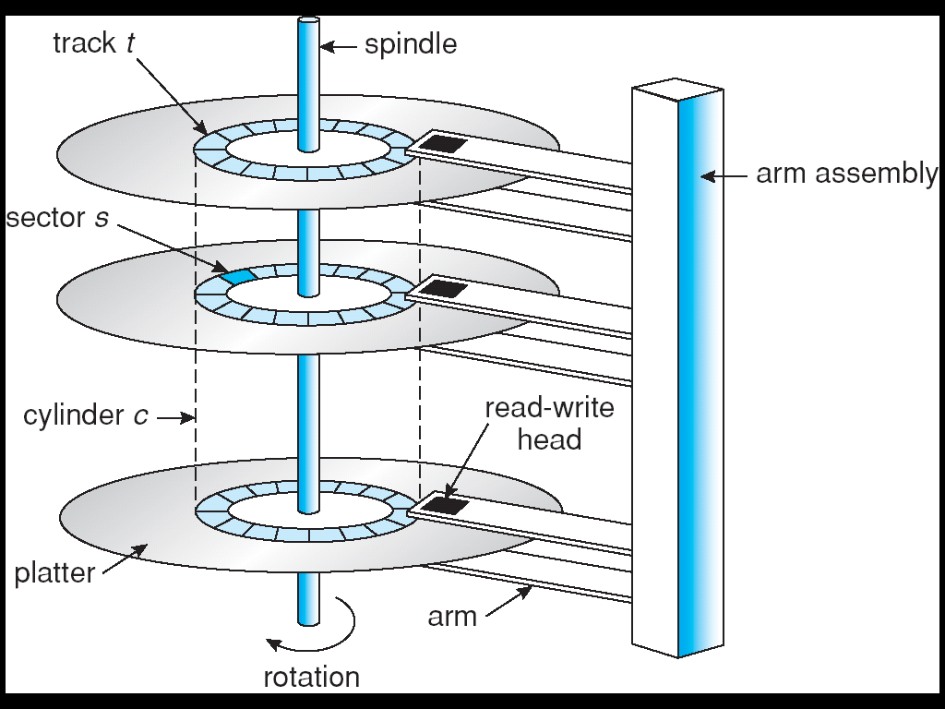
Moving-head Disk Mechanism
Notes:
platter轉盤 head磁頭 disk讀取是以sector為主體 track好像是一整圈 sector是一整圈上面的一小塊

Slide 6
Overview of Mass Storage Structure
Disks can be removable
Drive attached to computer via I/O bus
Busses vary, including EIDE, ATA, SATA, USB, Fibre Channel (FC), SCSI
Host controller in computer uses bus to talk to disk controller built into drive or storage array

Slide 7
Overview of Mass Storage Structure (Cont.)
Magnetic tape
Was early secondary-storage medium
Relatively permanent and holds large quantities of data
Access time slow sequential慢慢找 不是慢在傳輸 是慢在尋找
Random access ~1000 times slower than disk
Mainly used for backup, storage of infrequently-used data, transfer medium between systems
Kept in spool線軸 and wound or rewound past read-write head
Once data under head, transfer rates comparable to disk
20-200GB typical storage

Slide 8
12.2 Disk Structure
Disk drives are addressed as large 1-dimensional arrays of logical blocks, where the logical block is the smallest unit of transfer.
The 1-dimensional array of logical blocks is mapped into the sectors of the disk sequentially.
Sector扇形 0 is the first sector of the first track on the outermost cylinder.
Mapping proceeds in order through that track, then the rest of the tracks in that cylinder, and then through the rest of the cylinders from outermost to innermost.
Notes:
把整個磁碟編成一個1 dim arr 從整個立體cylinder最外圈的track裡面的每個sector 往內層的track逐一編

Slide 9
12.3 Disk Attachment
Host-attached storage accessed through I/O ports talking to I/O busses
SCSI itself is a bus, up to 可以接16 devices on one cable, SCSI initiator requests派工 operation and SCSI targets perform tasks 執行
Each target can have up to 8 logical units (disks attached to device controller)8個硬碟
FC (Fiber Channel) is high-speed serial architecture
Can be switched fabric這是一個概念豐富的專有名詞wiki with 24-bit address space – the basis of storage area networks (SANs) in which many hosts attach to many storage units
Can be arbitrated loop (FC-AL) of 126 devices
Notes:
https://en.wikipedia.org/wiki/Switched_fabric

Slide 10
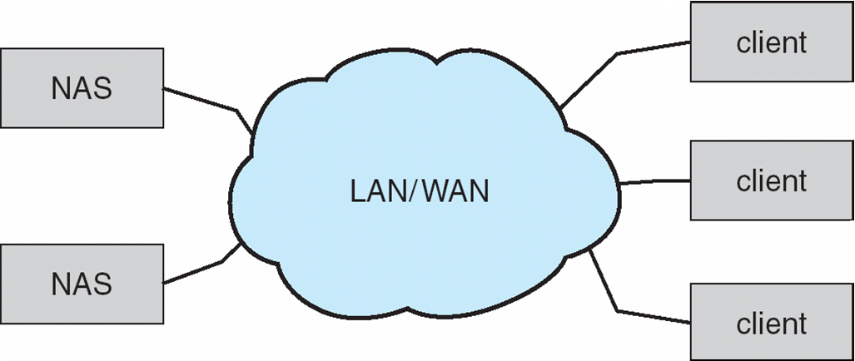
Network-Attached Storage (NAS)
Network-attached storage (NAS) is storage made available over a network rather than over a local connection (such as a bus)
NFS and CIFS are common protocols
Implemented via remote procedure calls (RPCs) between host and storage
New iSCSI protocol uses IP network to carry the SCSI protocol
Notes:
storage 不是直接跟電腦接 是透過網路 網路文件共享系統(Common Internet File System；CIFS)原先被稱為伺服器訊息區塊(Server Message Block；SMB)，Windows上的

Slide 11
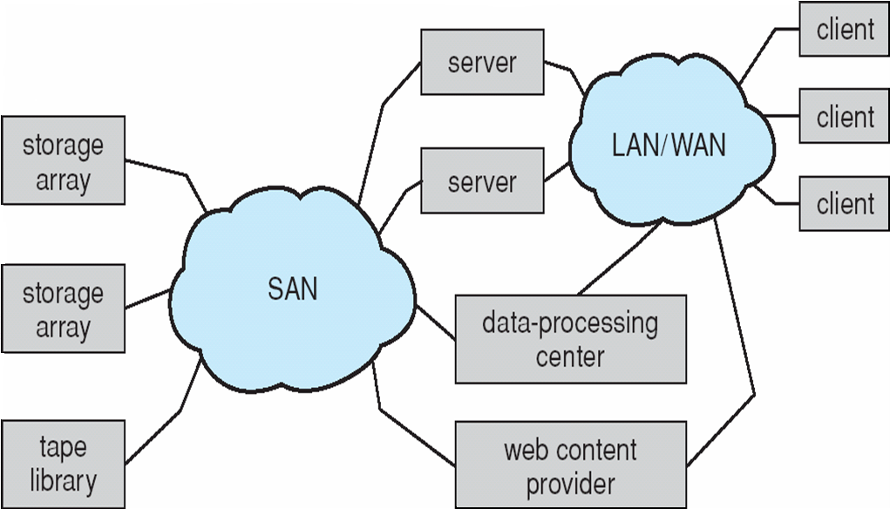
Storage Area Network (SAN)
Common in large storage environments (and becoming more common)
Multiple hosts attached to multiple storage arrays - flexible
Notes:
例如dropbox可能會用到 SAN也是storage+網路 但是比NAS規模更大 storage array 例如RAID 12-2

Slide 12
12.4 Disk Scheduling
The operating system is responsible for using hardware efficiently — for the disk drives, this means having a fast access time and disk bandwidth.
Access time has two major components
Seek time is the time for the disk arm to move the heads to the cylinder containing the desired sector.垂直
Rotational latency is the additional time waiting for the disk to rotate the desired sector to the disk head.水平
Minimize seek time
Seek time ≈ seek distance
Disk bandwidth is the total number of bytes transferred, divided by the total time between the first request for service and the completion of the last transfer.

Slide 13
Disk Scheduling (Cont.)
Several algorithms exist to schedule the servicing of disk I/O requests.
We illustrate them with a request queue (0-199 cylinders).
98, 183, 37, 122, 14, 124, 65, 67
Head pointer 53
Notes:
12-3

Slide 14
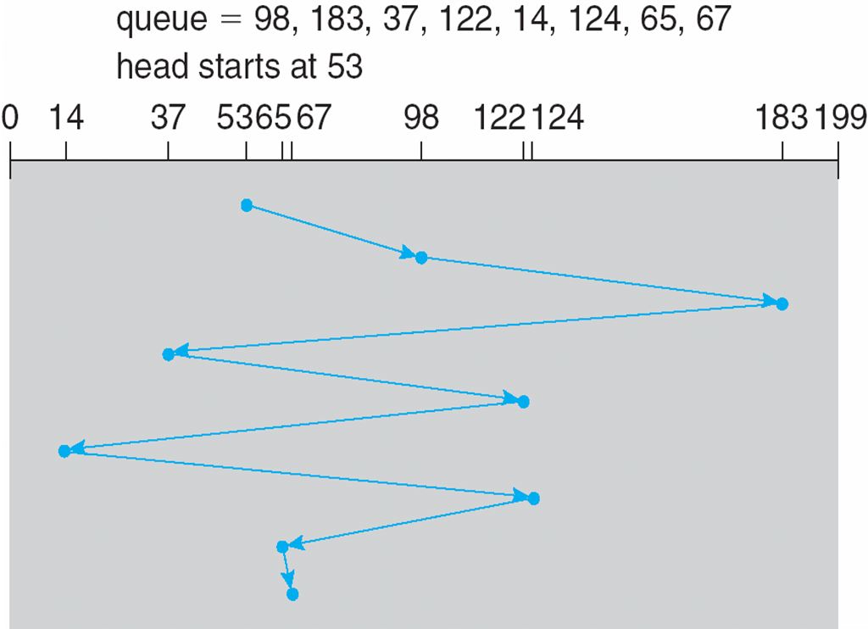
FCFS (First Come First Service)慢
Illustration shows total head movement of 640 cylinders.

Slide 15
SSTF (Shortest Seek Time First)ok
Selects the request with the minimum seek time from the current head position.
SSTF scheduling is a form of SJF scheduling; may cause starvation of some requests.
Illustration shows total head movement of 236 cylinders.
如果執行過程中有更短的進來 會以更短的進來會優先處理

Slide 16
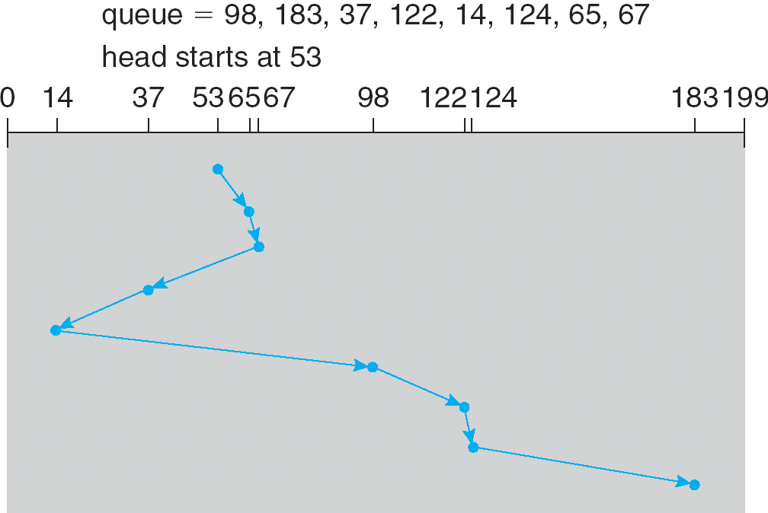
SSTF (Cont.)

Slide 17
SCAN
The disk arm starts at one end of the disk, and moves toward the other end, servicing requests until it gets to the other end of the disk, where the head movement is reversed and servicing continues.
Sometimes called the elevator algorithm.
Illustration shows total head movement of 208 cylinders.
電梯一直上下移動 看到request就服務(開門載人) 機械手臂從外移到內 再往外移 來回

Slide 18
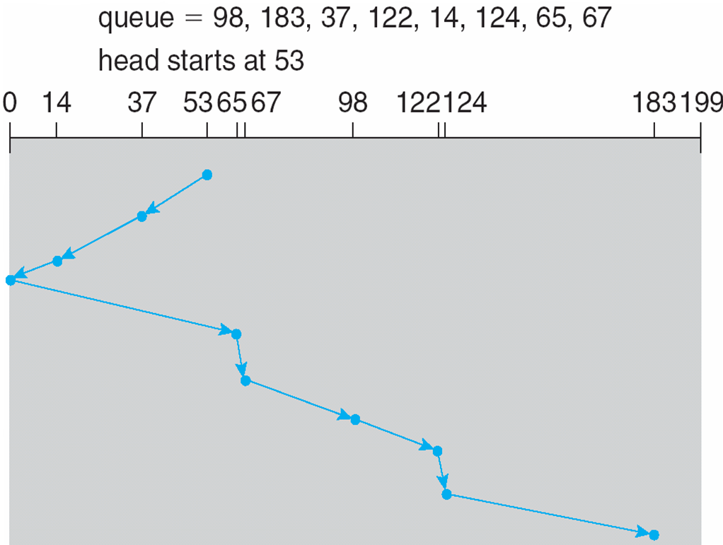
SCAN (Cont.)

Slide 19
C-SCAN
Provides a more uniform wait time than SCAN. 讓等待時間更一致 去服務 回不服務 類似線上繞圈
The head moves from one end of the disk to the other. servicing requests as it goes.
When it reaches the other end, however, it immediately returns to the beginning of the disk, without servicing any requests on the return trip.
Treats the cylinders as a circular list that wraps around from the last cylinder to the first one.

Slide 20
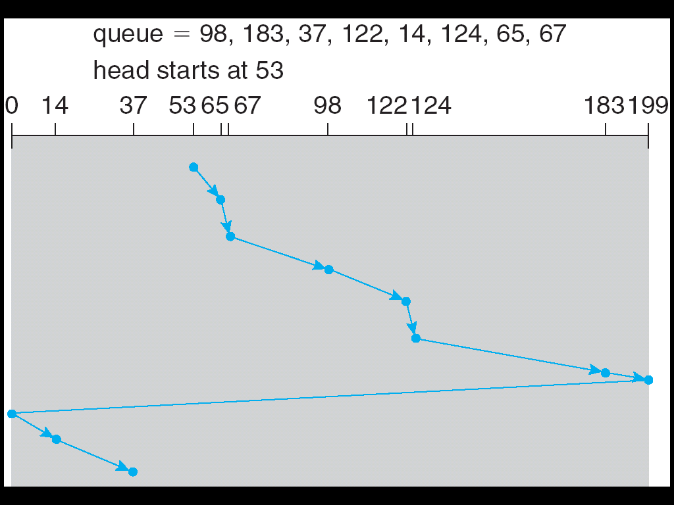
C-SCAN (Cont.)
No service

Slide 21
C-LOOK (or LOOK)
Versions of SACN and C-SCAN
Arm only goes as far as跟一樣遠 the last request in each direction 就是到實際有的最遠request就停不用到底, then reverses direction immediately, without first going all the way to the end of the disk.
They look for a request before continuing to move in a given direction.

Slide 22
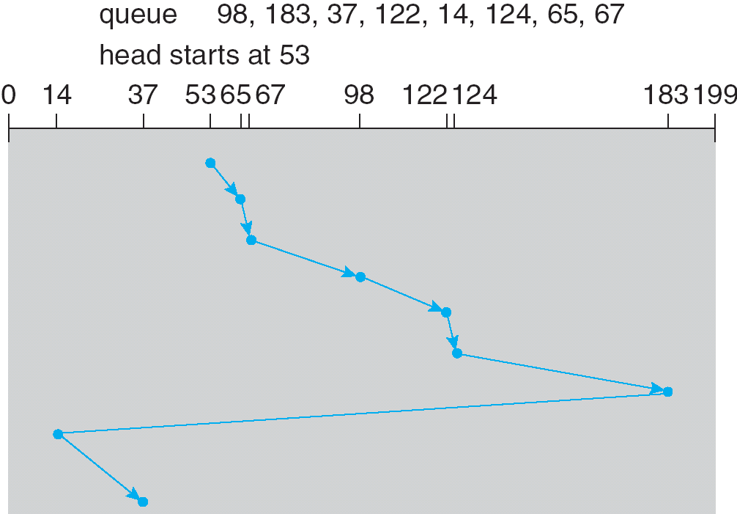
C-LOOK (Cont.)
Notes:
往右其實只到183就夠 不用到底199 所以改良版CLook

Slide 23
Selecting a Disk-Scheduling Algorithm
SSTF is common and has a natural appeal吸引力
SCAN and C-SCAN perform better for systems that place a heavy load on the disk.
Performance depends on the number and types of requests.
Requests for disk service can be influenced by the file-allocation method. 檔案擺放方式 連續? 分散?
The disk-scheduling algorithm should be written as a separate module of the operating system, allowing it to be replaced with a different algorithm if necessary.
Either SSTF or LOOK is a reasonable choice for the default algorithm.
Notes:
12-4 end

Slide 24
12.5 Disk Management
Low-level formatting, or physical formatting — Dividing a disk into sectors that the disk controller can read and write.
To use a disk to hold files, the operating system still needs to record its own data structures on the disk.
Partition the disk into one or more groups of cylinders.
Logical formatting or “making a file system檔案系統”.
Boot block initializes system.
The bootstrap is stored in ROM(唯讀不能改).
Bootstrap loader program. 這邊的bootstrap師說不放在ROM放在硬碟 要改就可以改
Methods such as sector sparing 騰出 節約 備用 備份 used to handle bad blocks. 壞掉時可以取代

Slide 25
Booting from a Disk in Windows 2000
The Windows 2000 system places it boot code in the first sector on the hard disk (Master boot record, MBR).
Windows 2000 allows a hard disk to be divided into one or more partitions; one partition, identified as the boot partition, contains the OS and device drivers.
Once the system identifies the boot partition, it reads the first sector from that partition (which is called the boot sector) and continues with the remainder of the boot process.

Slide 26
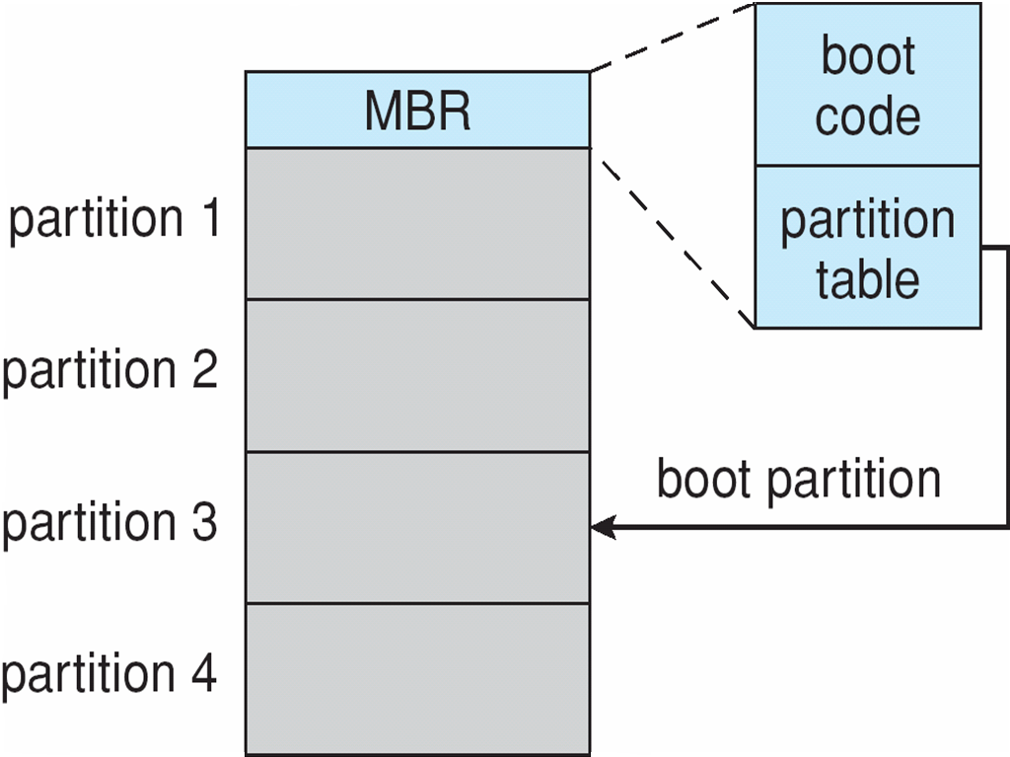
Booting from a Disk in Windows 2000
boot sector
Notes:
電腦開機後 到ROM執行boostrap 會到disk的MBR Master boot record 內有b cod p table 然後到boot所在的part 將boot 載入到mem執行 就會把OS下載到boot partition boot 短靴

Slide 27
12.6 Swap-Space Management
Swap-space — Virtual memory uses disk space as an extension of main memory. 程式很大 不用全放mem 部分即可 例如frame mem – page disk 找不到就要swap inout
Swap-space can be carved 雕刻 out of the normal file system or, more commonly, it can be in a separate disk partition.
Swap-space management
4.3BSD allocates swap space when process starts; holds text segment (the program) and data segment.
Kernel uses swap maps to track swap-space use.
Solaris 2 allocates swap space only when a page is forced out of physical memory, not when the virtual memory page is first created.

Slide 28
Swapping on Linux Systems
Linux allows one or more swap areas to be established.
A swap area may be either a swap file on a regular file system or a raw-swap-space partition.
Each swap area consists of a series of 4KB page slots(page大小4KB), which are used to hold swapped pages.
Each swap area is associated with a swap map.
Counter = 0, the corresponding page slot is available.沒人用
Counter >0, the page slot is occupied by a swapped page. The value of the counter indicates the number of mappings to the swapped page. Counter =3, the swapped paged is storing a region of memory shared by three processes.

Slide 29
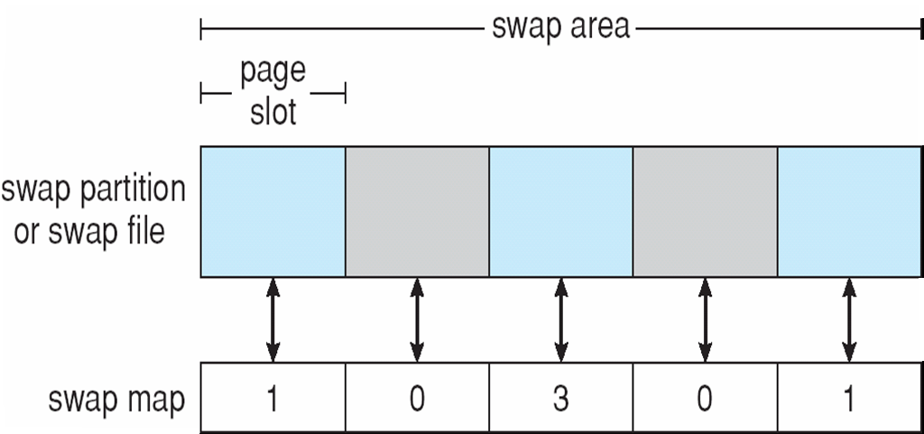
Data Structures for Swapping on Linux Systems
4KB
The value of the counter indicates the number of mappings to the swapped page
Notes:
長方形是swap area 灰可用 藍被使用 12-5 end

Slide 30
12.7 RAID Structure
RAID (Redundant Arrays of Independent Disks) – multiple disk drives provides reliability via redundancy.
RAID is arranged into seven different levels.
With multiple disks, we can improve the transfer rate by striping data across the disks. ex資料有4blocks 分散在4個硬碟各一個 讀的時候從4個disk同時讀 就快四倍
Data striping條紋 consists of splitting the bits of each byte across multiple disks – bit level striping
^ 舉例沒效率不會這樣做 ex把8bit拆成8個分到8disk
Block-level striping consists of splitting the blocks of each file across multiple disks. 比較有效率

Slide 31
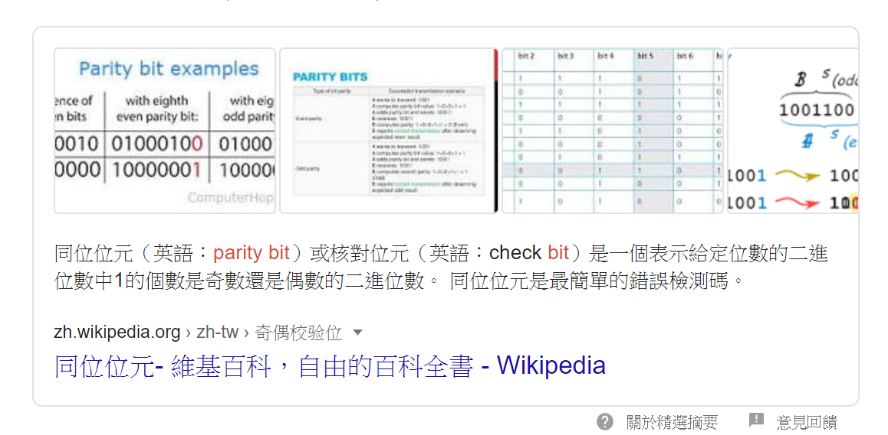
RAID (cont)
Several improvements in disk-use techniques involve the use of multiple disks working cooperatively.
Disk striping uses a group of disks as one storage unit.
RAID schemes improve performance平行讀 and improve the reliability of the storage system by storing redundant data.
Mirroring(copy備份複製) or shadowing keeps duplicate of each disk.
Block interleaved parity uses much less redundancy多餘.
parity是在通訊上很重要的通訊檢查碼 例如8bit 加一碼even 或odd 個1 例如00000000 1數量偶數 所以是even 但是如果發現資料來的有奇數個1 就代表資料錯誤 就可error detec 如果只錯一兩個bit 還可以比對修復錯誤 錯太多沒辦法

Slide 32


RAID (cont)
RAID level 0: RAID level 0 refers to disk arrays with striping at the level of blocks but without any redundancy.我看懂了 純stripe依序分配 可增加4倍讀速
但沒增加可靠度
RAID level 1: RAID level 1 refers to disk mirroring(copy一份 但沒有strip).

Slide 33

RAID (cont)
RAID level 2: RAID level 2 also known as memory-style error-correcting-code (ECC) organization. The parity bits are used. The disks labeled P store the error-correction bits.
parity只能檢查1個bit錯和修補 2個以上錯就不準了
P > parity P放的越多 越多資訊可以救援 記憶體
Notes:
RAID 2 用mem parity

Slide 34

RAID (cont)
RAID level 3: RAID level 3 refers to bit-interleaved parity organization improves on level 2 by taking into account the fact that, unlike memory systems, disk controllers can detect whether a sector has been read correctly, so a single parity bit can be used for error correction and for detection.
Notes:
interleave插空白頁於書頁間；插入，插 RAID 3 用 disk controller 讀的時候就能判斷對錯 所以mem不用用那麼多 parity也可以減少量

Slide 35

RAID (cont)
RAID level 4: RAID level 0 refers to block-interleaved parity organization, uses block-level striping, as in RAID 0, and also keeps a parity block on a separate disk for corresponding blocks from N other disks.
Notes:
RAID 3 bit level RAID 4 block level 12-6 end

Slide 36
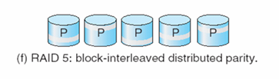
RAID (cont)
RAID level 5: RAID level 5 refers to block-interleaved distributed parity, differs from level 4 by spreading data and parity among all N+1 disks, rather than storing data in N disks and parity in one disk.
For each block, one of the disks stores the parity, and the others store data.
With an array of five disks, the parity for the nth block is stored in disk (n mod 5)+1; the nth blocks of the other four disks store actual data for the block.
A parity block cannot store parity for the blocks in the same disk.
Notes:
level 5 比 4 多了distributed 所以可以看到 4 是 P 在一個獨立的disk 5 是分散在每一個

Slide 37

RAID (cont)
RAID level 6, P+Q redundancy scheme is much like RAID 5 but stores extra redundant information to guard against multiple disk failures.
Instead of parity, error-correcting codes such as Reed-Solomon codes are used. 2 bits of redundant data are stored for every 4 bits of data – compared with 1 parity bit in level 5 – and the system can tolerate two disk failures.
Notes:
可壞兩顆 每4個bit 用兩個bit去備份 使得4 bit 任意錯兩個bit都可以救回來

Slide 38
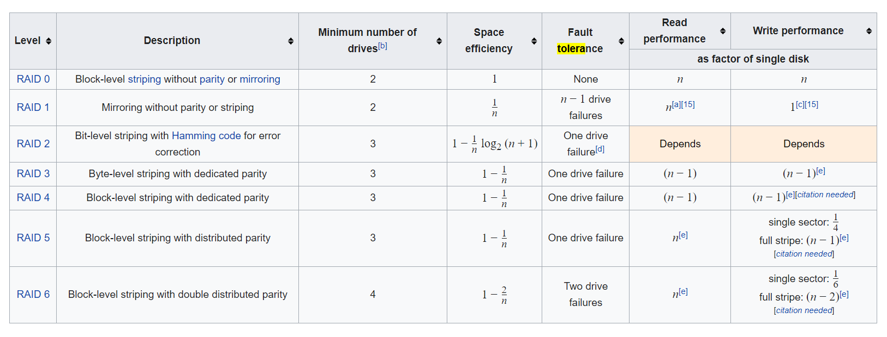
https://en.wikipedia.org/wiki/Standard_RAID_levels Wiki 有寫每一類Tolerance的數量 和摘要
Notes:
1 drive tolerance 表 任一顆壞掉都可救 因為一顆壞 上面的data可以用其他顆的parity救回 上面的parity壞 data本來就存在其他顆 沒影響

Slide 39
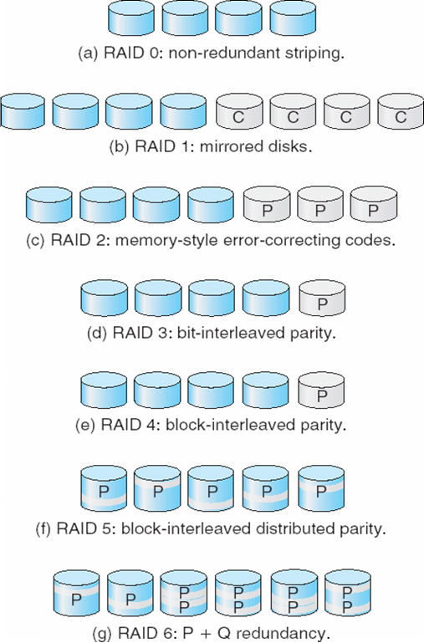
RAID Levels
Notes:
整理

Slide 40
RAID (cont)
RAID 0 provides the performance, 平行
RAID 1 provides the reliability. mirror 沒平行加速
RAID 0 +1 : A set of disks are striped, and then the stripe is mirrored to another, equivalent strip 先0再1
RAID 1+0: Disks are mirrored in pairs and then the resulting mirrored pairs are striped. 先1再0
RAID 1+0 has some theoretical advantages over RAID 0+1.
For example, if a single disk fails in RAID 0+1, an entire strip is inaccessible, leaving only the other strip available. With a failure in RAID 1+0, a single disk is unavailable, but the disk that mirrors it is still available, as are all the rest of the disks.見下頁圖

Slide 41
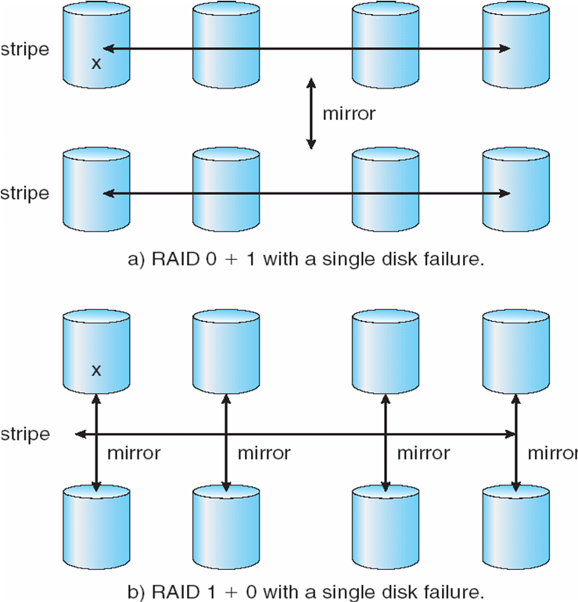
RAID (0 + 1) and (1 + 0)
Notes:
0+1先分散再複製 因為0本身沒有容錯 所以錯一個單邊全部都沒用了 但是1+0 類似 1個先copy出下面一個 然後再往右繼續copy 所以 單邊錯一個 其他看起來都是copy 所以都可用 不過我就想這樣真的有0的parity ??

Slide 42
12.8 Stable-Storage Implementation
Write-ahead log scheme requires stable storage log要穩定 建立在硬碟本身也要穩定.
To implement stable storage:
Replicate information on more than one nonvolatile storage media with independent failure modes. 多複製幾分
Update information in a controlled manner to ensure that we can recover the stable data after any failure during data transfer or recovery.

Slide 43
12.9 Tertiary第三階 Storage Structure
Low cost is the defining characteristic of tertiary storage.要存大量資料 所以要便宜才不會太貴
Generally, tertiary storage is built using removable media 隨身 可攜帶 可移動 可移除
Common examples of removable media are floppy disks少用了 不夠大 讀得快 但找磁頭位置慢 找到後讀得快 and CD-ROMs; other types are available. 下頁

Slide 44
Removable Disks
Floppy disk — thin flexible disk coated with magnetic material, enclosed in a protective plastic case.
Most floppies hold about 1 MB; similar technology is used for removable disks that hold more than 1 GB.
Removable magnetic disks can be nearly as fast as hard disks, but they are at a greater risk of damage from exposure.

Slide 45
Removable Disks (Cont.)
A magneto磁力-optic光學 disk records data on a rigid堅硬的 platter coated with magnetic material.
Laser heat is used to amplify a large, weak magnetic field to record a bit.
Laser light is also used to read data (Kerr effect).
The magneto-optic head flies 光學磁帶 很少用 師講簡略much farther from the disk surface than a magnetic disk head, and the magnetic material is covered with a protective layer of plastic or glass; resistant to head crashes.
Optical disks do not use magnetism; they employ special materials that are altered by laser light. 用雷射光打洞burn 有些燒完就不能再改

Slide 46
WORM Disks
The data on read-write disks can be modified over and over.
WORM (“Write Once, Read Many Times”) disks can be written only once.
Thin aluminum鋁 film sandwiched between two glass or plastic platters.
To write a bit, the drive uses a laser light to burn a small hole 燒洞 through the aluminum; information can be destroyed by not altered.
Very durable and reliable. 可靠 因為洞燒了就不能改了
Read Only disks, such as CD-ROM and DVD, come from the factory with the data pre-recorded. 現在有些光碟可以重複寫

Slide 47
Tapes
Compared to a disk, a tape is less expensive and holds more data便宜更大, but random access is much slower.要從頭開始跑 不能用在快速存取
Tape is an economical medium for purposes that do not require fast random access, e.g., backup copies of disk data, holding huge volumes of data.
Large tape installations typically use robotic tape changers that move tapes between tape drives and storage slots in a tape library. 師下略
stacker – library that holds a few tapes
silo – library that holds thousands of tapes
A disk-resident file can be archived to tape for low cost storage; the computer can stage it back into disk storage for active use.

Slide 48
Operating System Support
Major OS jobs are to manage physical devices and to present a virtual machine abstraction to applications
For hard disks, the OS provides two abstraction:
Raw device – an array of data blocks. 把儲存體看成資料array
File system – the OS queues and schedules the interleaved交錯 requests from several applications.

Slide 49
Application Interface
Most OSs handle removable disks almost exactly like fixed disks— a new cartridge彈藥筒 is formatted and an empty file system is generated on the disk.
Tapes are presented as a raw storage medium, i.e., and application does not open a file on the tape, it opens the whole tape drive as a raw device.
Usually the tape drive is reserved for the exclusive use of that application.
Since the OS does not provide file system services, the application must decide how to use the array of blocks.
Since every application makes up its own rules for how to organize a tape, a tape full of data can generally only be used by the program that created it. ok 好懂

Slide 50
Tape Drives
The basic operations for a tape drive differ from those of a disk drive.
locate positions the tape to a specific logical block, not an entire track (corresponds to seek).
The read position operation returns the logical block number where the tape head is.
The space operation enables relative motion.
Tape drives are “append-only” devices; updating a block in the middle of the tape also effectively erases everything beyond that block.
An EOT mark is placed after a block that is written.

Slide 51
File Naming
The issue of naming files on removable media is especially difficult when we want to write data on a removable cartridge 彈藥筒 on one computer, and then use the cartridge in another computer. 因為tape比較沒標準化 看寫入的app規則是什麼 拿到其他電腦其他applicaton可能就看不懂
Contemporary當代的 OSs generally leave the name space problem unsolved for removable media, and depend on applications and users to figure out how to access and interpret the data. 所以OS不管 交給app自己去處理
Some kinds of removable media (e.g., CDs) are so well standardized that all computers use them the same way.

Slide 52
Hierarchical Storage Management (HSM)
A hierarchical storage system extends the storage hierarchy beyond primary memory and secondary storage to incorporate tertiary storage — usually implemented as a jukebox自動唱機/卡帶 of tapes or removable disks.
Usually incorporate tertiary storage by extending the file system.
Small and frequently used files remain on disk.
Large, old, inactive files are archived to the jukebox.
HSM is usually found in supercomputing centers and other large installations that have enormous volumes of data.
Notes:
HSM (Hierarchical Storage Management )

Slide 53
Speed
Two aspects of speed in tertiary storage are bandwidth and latency.
Bandwidth is measured in bytes per second.
Sustained維持 bandwidth – average data rate during a large transfer; # of bytes/transfer time. Data rate when the data stream is actually flowing.
Effective bandwidth – average over the entire I/O time, including seek or locate, and cartridge 彈藥筒 switching. 緯創比較嚴 還靠到9:01被扣薪水 Drive’s overall data rate

Slide 54
Speed (Cont.)
Access latency – amount of time needed to locate data.
Access time for a disk – move the arm to the selected cylinder and wait for the rotational latency; < 35 milliseconds.
Access on tape requires winding the tape reels until the selected block reaches the tape head; tens or hundreds of seconds. Sccess時間 一萬倍
Generally say that random access within a tape cartridge is about a thousand 千倍 times slower than random access on disk.
The low cost of tertiary storage is a result of having many cheap cartridges share a few expensive drives.
A removable library is best devoted to the storage of infrequently used data, because the library can only satisfy a relatively small number of I/O requests per hour.

Slide 55
Reliability
A fixed disk drive is likely to be more reliable than a removable disk or tape drive.
An optical cartridge is likely to be more reliable than a magnetic disk or tape. 磁頭磨到磁碟表面就刮傷
A head crash in a fixed hard disk generally destroys the data, whereas反之 the failure of a tape drive or optical disk drive often leaves the data cartridge unharmed.

Slide 56
Cost
Main memory is much more expensive than disk storage
The cost per megabyte of hard disk storage is competitive with magnetic tape if only one tape is used per drive.
The cheapest tape drives and the cheapest disk drives have had about the same storage capacity over the years.
Tertiary storage gives a cost savings only when the number of cartridges is considerably larger than the number of drives.

Slide 57
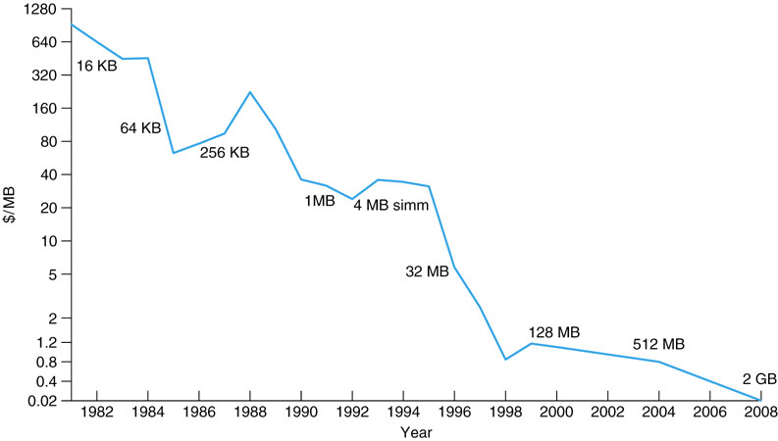
Price per Megabyte of DRAM From 1981 to 2008

Slide 58
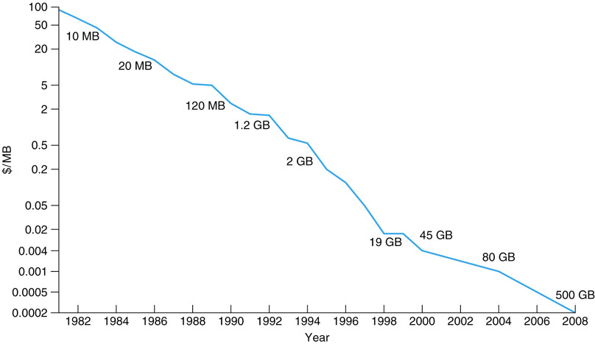
Price per Megabyte of Magnetic Hard Disk From 1981 to 2008

Slide 59
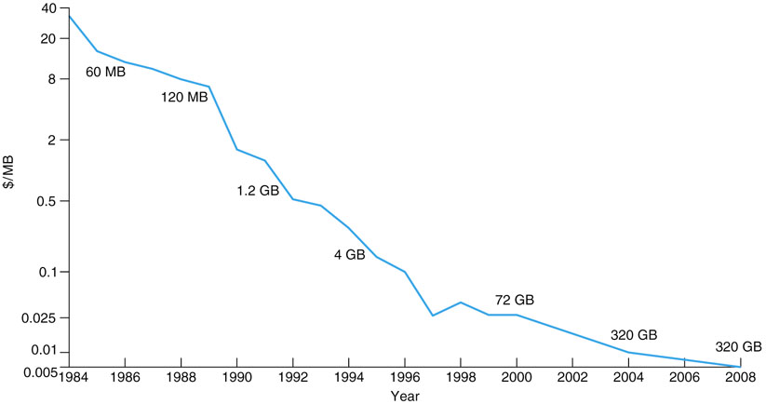
Price per Megabyte of a Tape Drive From 1984-2008

Slide 60
End of Chapter 12

